Slide 1
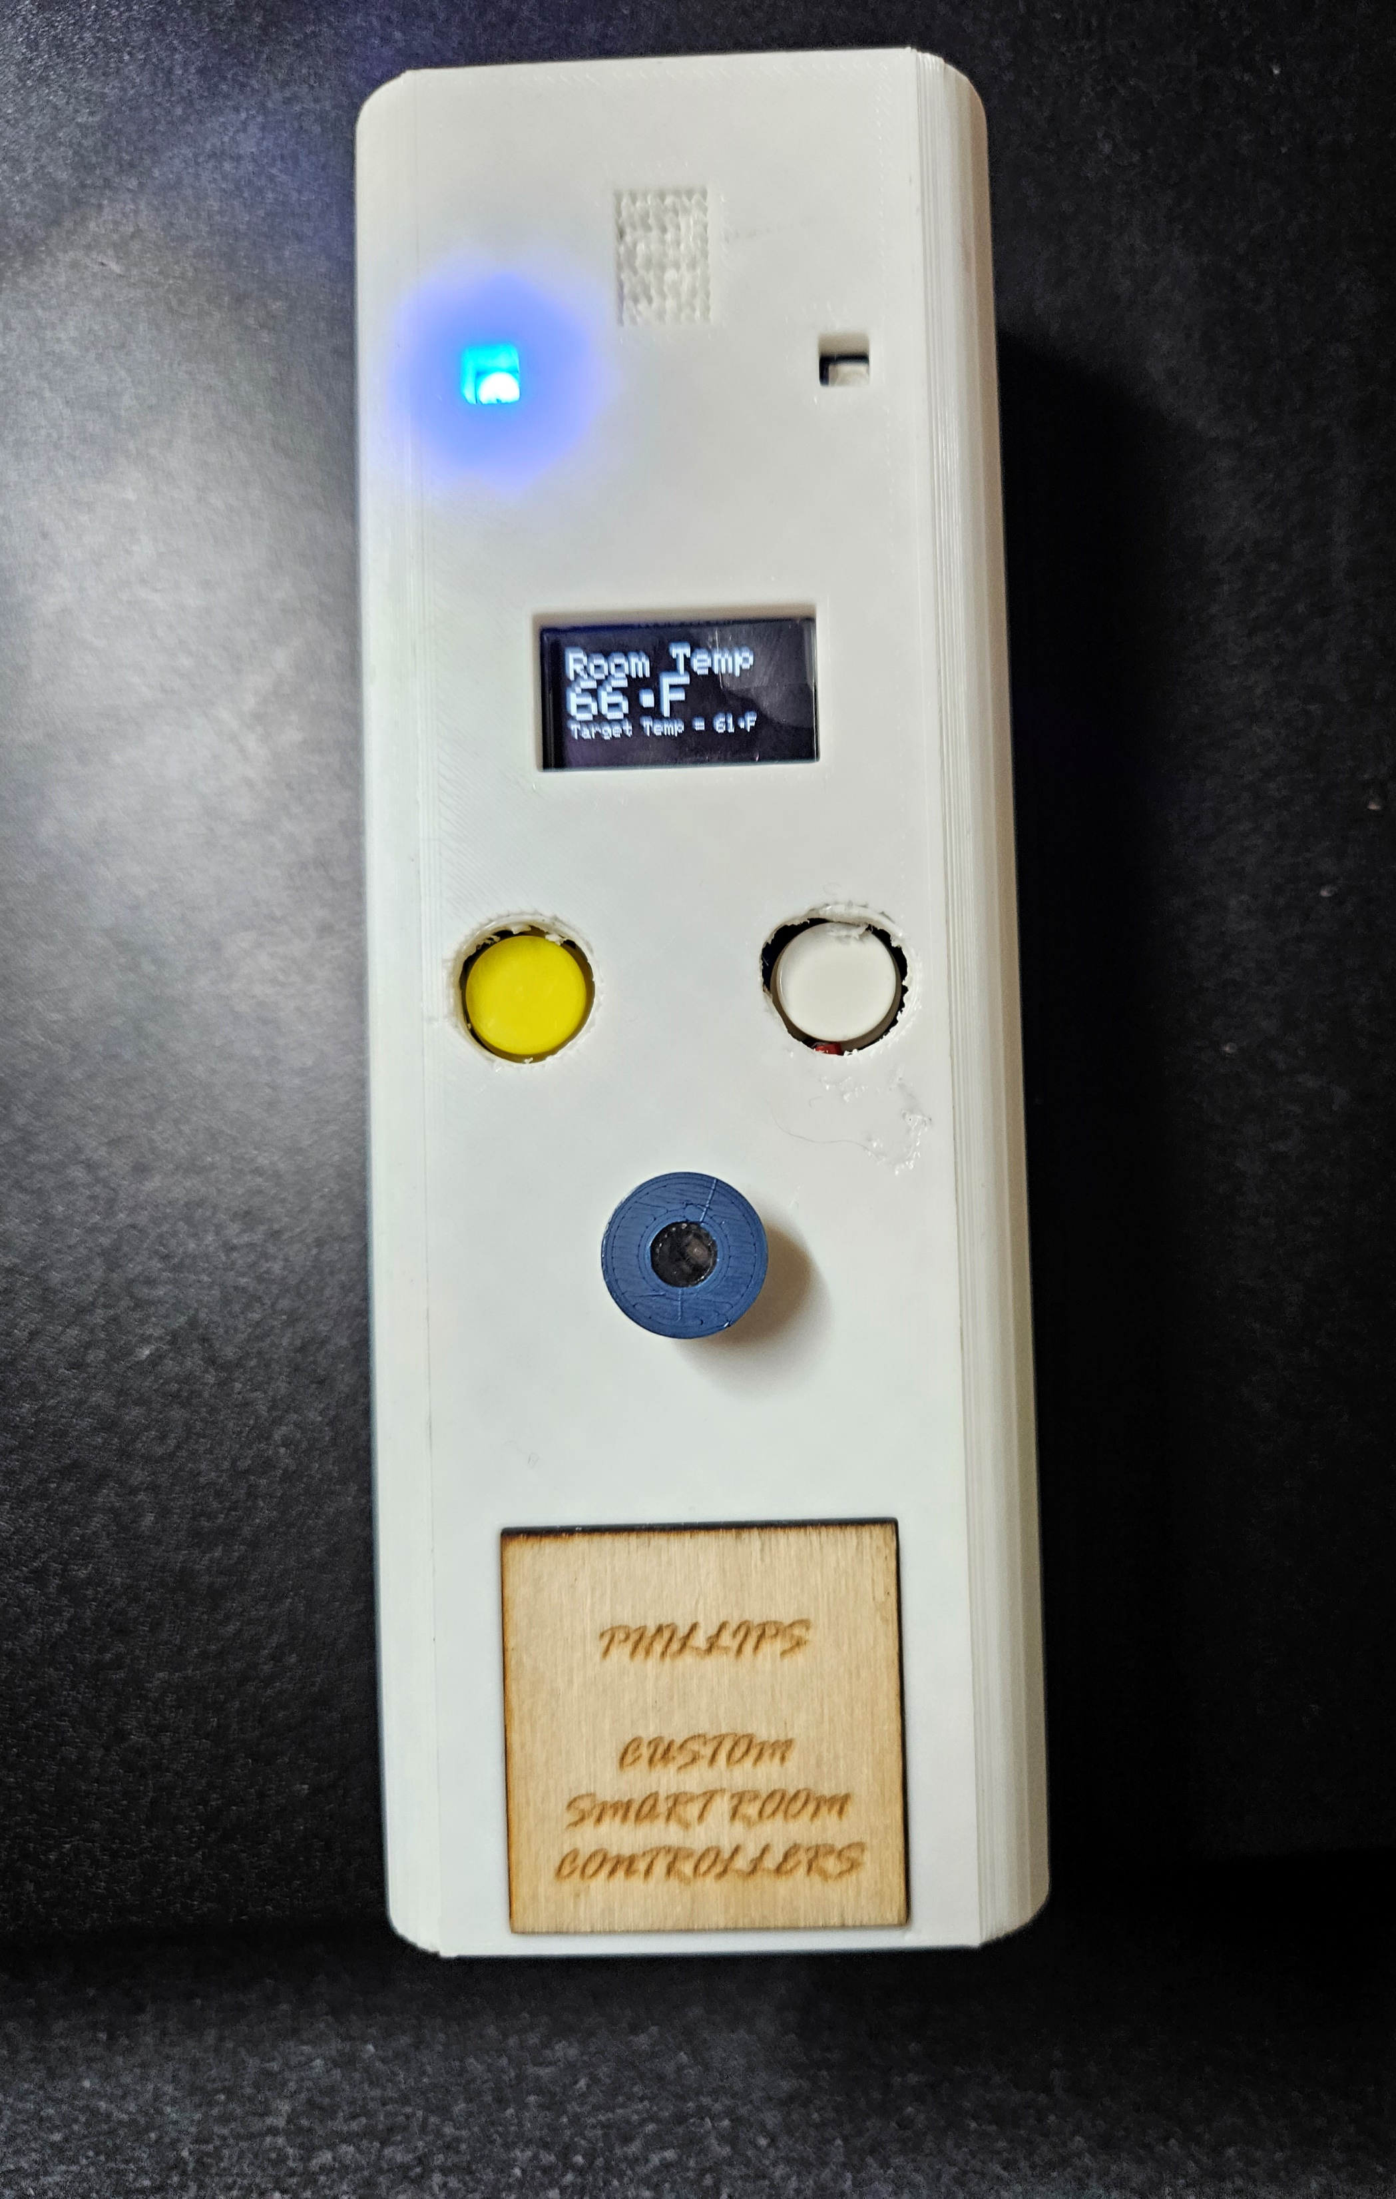
Phillips Custom Smart Room Controller

Slide 2

Project Inspiration
Ease of access to those with mobility issues
Cost effectiveness provided by the automation of heating and cooling systems
To allow myself to be as lazy as humanly possible

Slide 3
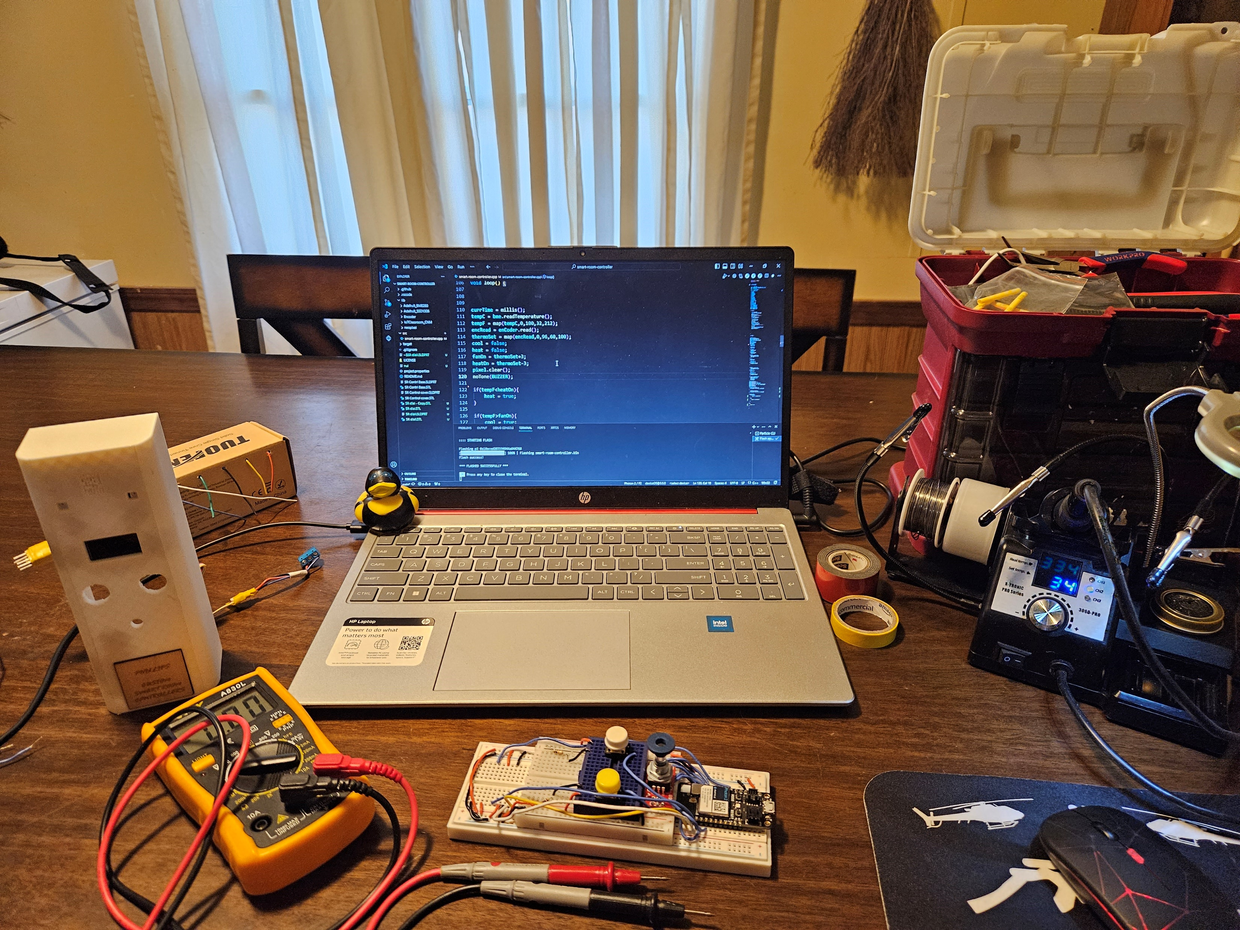
Prototyping Process
3D Modeling and printing
Wiring
Coding
Final assembly

Slide 4
3D Modeling Printing and design
3D Modeling was done using SolidWorks and was completed in 3 parts
Bottom tray for bread board
Cover / enclosure
Encoder knob
3D printing was completed on a Bambu Labs 3D printer in the IoT classroom at FUSE Makerspace
Logo was made using an Epilog laser cutter and engraver, also at FUSE Makerspace

Slide 5
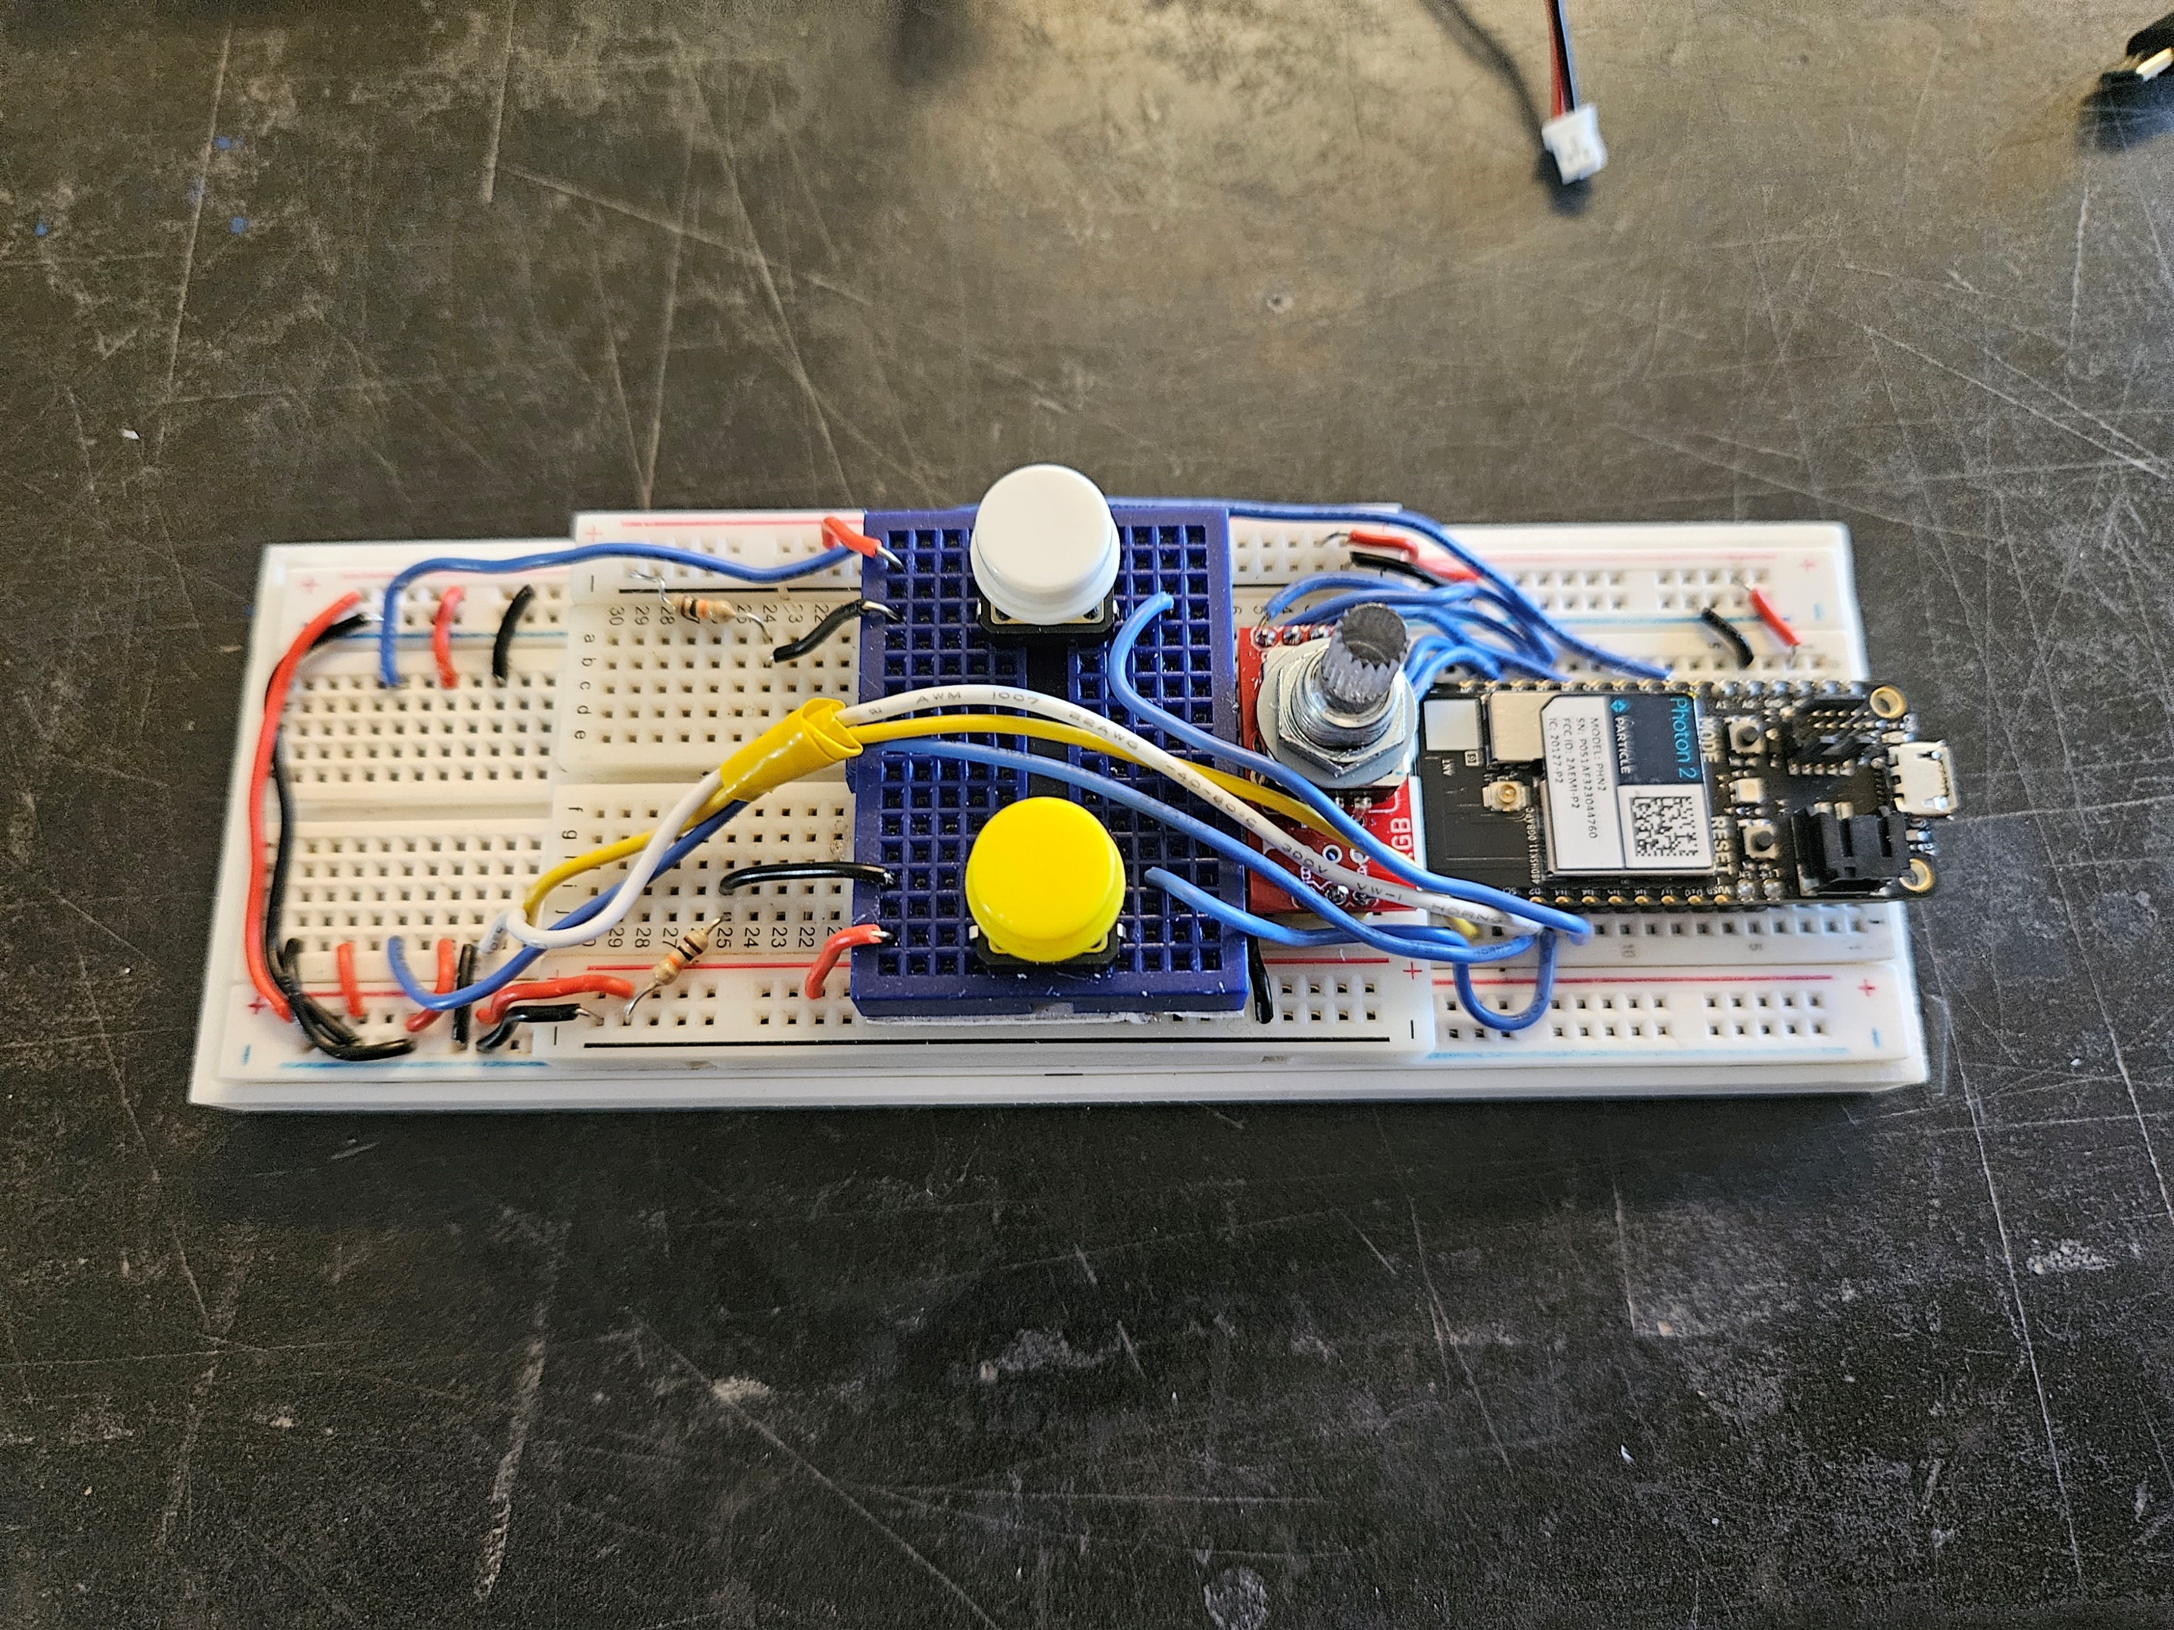
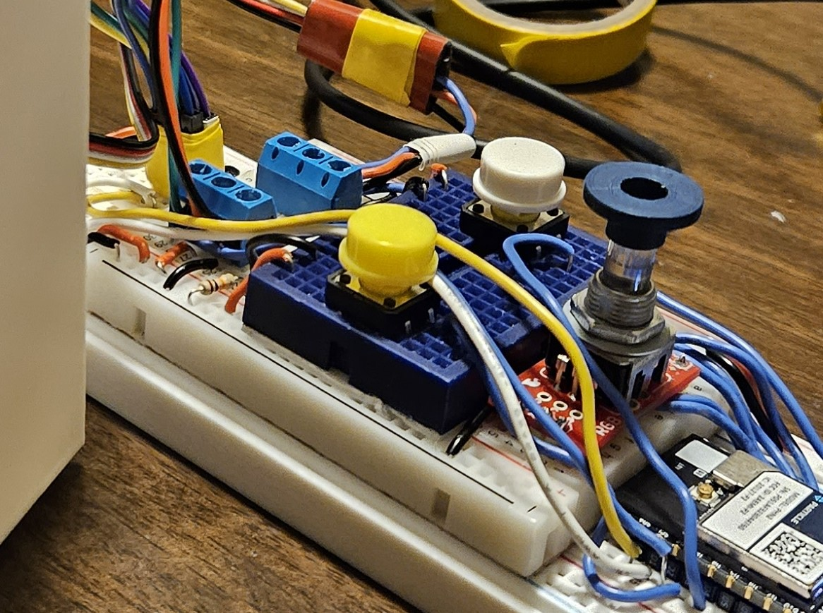
Wiring
Multiple bread boards
Power supply issue
Made my own plugs to simply process of connecting enclosure to base

Slide 6
Parts Used
Particle Proton 2
Buttons X2
Buzzer
Rechargeable battery
Slide switch
OLED display
Temperature sensor
Neo Pixels X2
Encoder

Slide 7
Coding
Pretty straight forward with only 2 major issues
Button functions
Buzzer If loop
Thanks EJ
Int counter = 0 ;
If(heater is on){
counter++;
}
Else{
counter = 0
}
If(counter == 1);
sound buzzer

Slide 8
Final Assembly
Biggest problem was room for wiring
Had to reprint enclosure to increase room
LET’S SEE HOW IT WORKS!!

